Slide 1

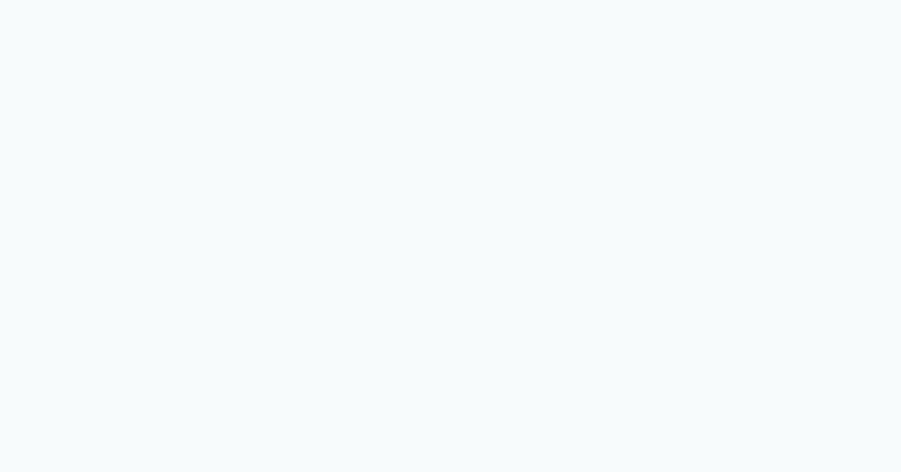
INF 428/528 FINAL PROJECT
Predictive Model for Service Calls Payment
Yashoda Rishita Pothunuri
001570390

Slide 2
Outline
What is the purpose of this project?
Predictive Modeling
Data Preparation
Modeling Methods
How we start working on our Model
Splitting the Data and Scaling the variables
Imputing the missing variables and Logistic Regression
Prediction and Results
Flask Application
Workflow
Templates
Starting the Application

Slide 3

What is the purpose of this project?
This project seeks to create a predictive model that can accurately detect which clients will most likely call in to make service payments within the next five days. This model will be used for preemptive emails sent out to customers in order to urge them to make their payments online, regardless of whether they have been given advance notice or not. By leveraging information on clients who have bills due within the next five days, the model's success in catalyzing payment-making activities can be accurately determined.

Slide 4
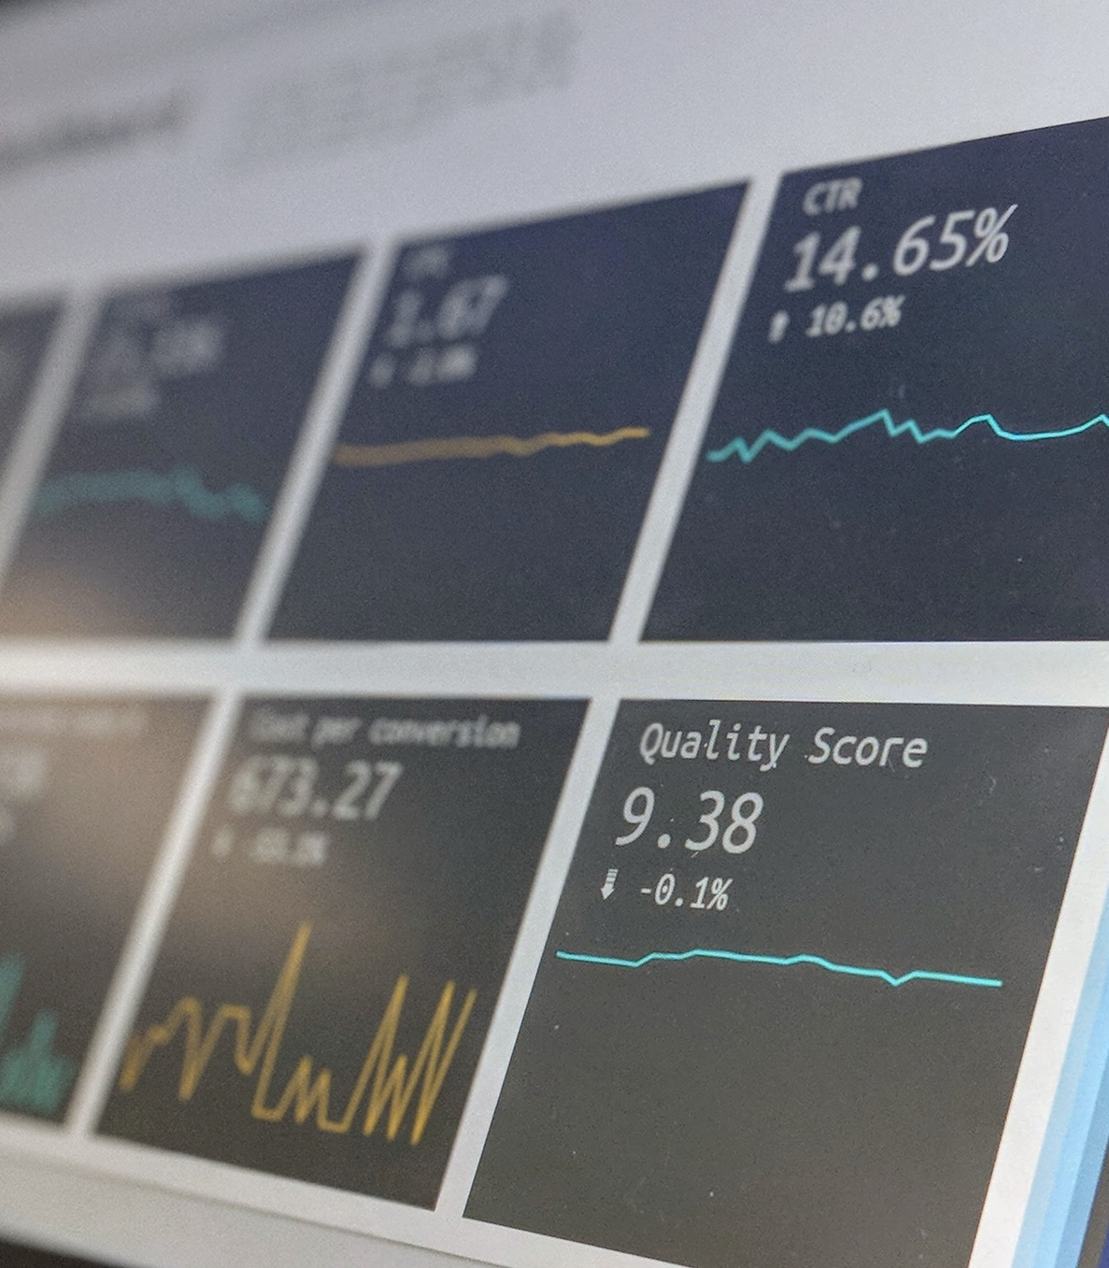
Predictive Modeling
"Predictive modeling is the process of using data to make predictions about future outcomes. By analyzing patterns and relationships in historical data, predictive models can be used to identify risks, opportunities, and trends, and to forecast future events with a high degree of accuracy." - Joseph Rickert, Data Scientist at RStudio

Slide 5

Data Preparation
During the initial stage of creating a prediction model, it is important to prepare the data. To start, we will import the data and identify any missing, outlier, or other data quality issues. We utilize the make_pipeline object and the SimpleImputer class to substitute missing data with a predetermined value, i.e. mean, median, or most common value or to propagate the most recent known outcome forwards or backwards.

Slide 6

Modeling Methods
A logistic regression model will be used to forecast the chances of each policyholder making a service payment call (CALL_FLAG=1). This type of model is particularly useful in this situation since it is a binary classification problem and logistic regression is one of the most popular approaches for dealing with such issues. It also provides transparent coefficients that help us to understand the relationship between the input and output variables which is essential in any forecasting task.

Slide 7
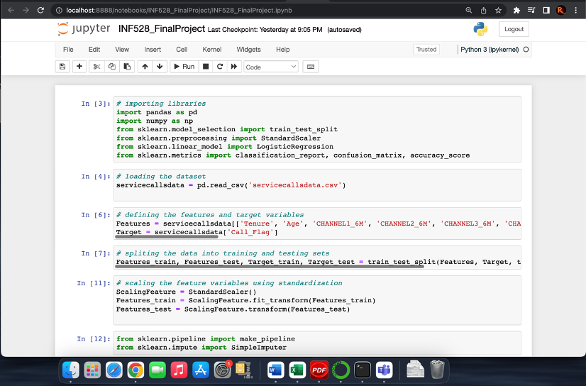
How we start working on our Model
The first line includes the pandas library, which is employed to manipulate and analyze data. The second line imports the numpy package, which is implemented in Python for scientific computation. The third line imports train_test_split from scikit-learn's model_selection module, which serves to split the dataset into training and testing sets. The fourth line imports StandardScaler from scikit-learn's preprocessing module, which functions for normalizing the feature variables. The fifth line imports LogisticRegression from scikit-learn's linear_model module, which serves to apply a logistic regression model to the data. The sixth line imports classification_report, confusion_matrix, and accuracy_score from scikit-learn's metrics module, which are used to evaluate the model's performance.

Slide 8
Splitting the Data and Scaling the variables
We used the scikit-learn function train_test_split in order to divide the feature and target variables into training and testing sets, with the testing set size being 30% and a random state of 0 for consistency. We then created a StandardScaler object which was subsequently applied to both the training and testing sets, so that the feature variables could be standardized.

Slide 9
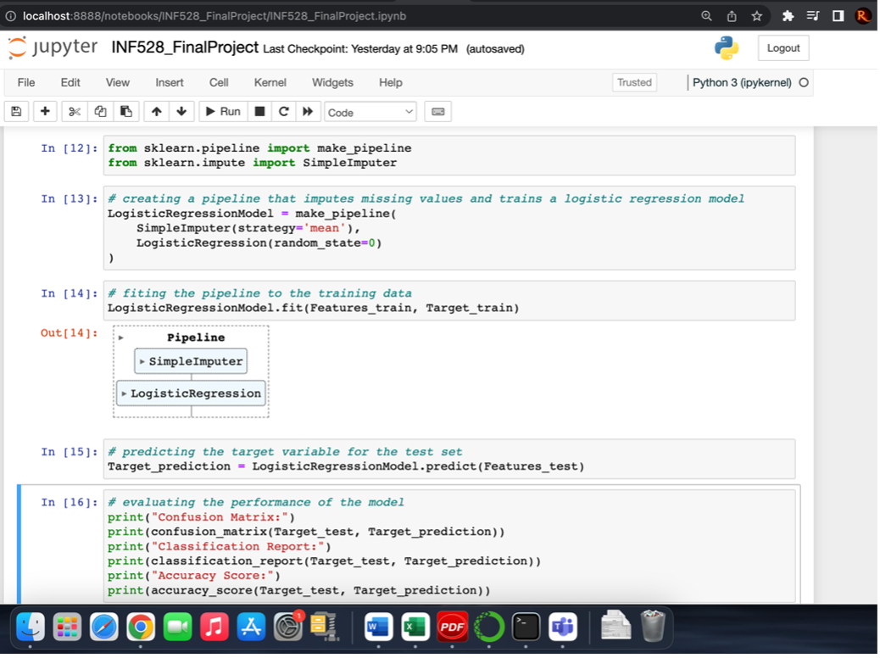
Imputing the missing variables and Logistic Regression
We utilize the make_pipeline object and the SimpleImputer class to replace all missing values with the most commonly observed value. Utilizing logistic regression, we can analyze historical data of policyholders who made service payment calls in order to discover which factors are associated with a higher probability of making a CALL_FLAG = 1. Through this analysis, pertinent demographic variables, payment behavior, payment amount and other relevant variables can be identified and leveraged to forecast the chance of a customer making a service payment call.

Slide 10
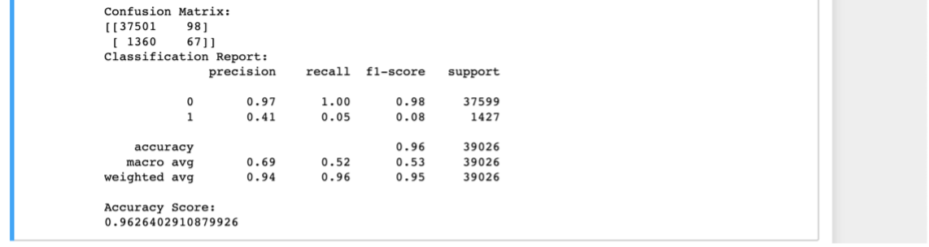
Prediction and Results
The trained model is used to forecast the target variable for the testing set in this line. The results of the model on the testing set's confusion matrix, classification report, and accuracy score are seen in the output. The confusion matrix and classification report show that the model is performing well when predicting the negative class (0), with high precision and recall. However, it has low precision and recall when it comes to the positive class (1), indicating that it is not doing well in detecting clients who are likely to make a service payment call. The accuracy score of 0.9626 is quite high; however, it can be deceptive in imbalanced datasets in which the negative class predominates.

Slide 11
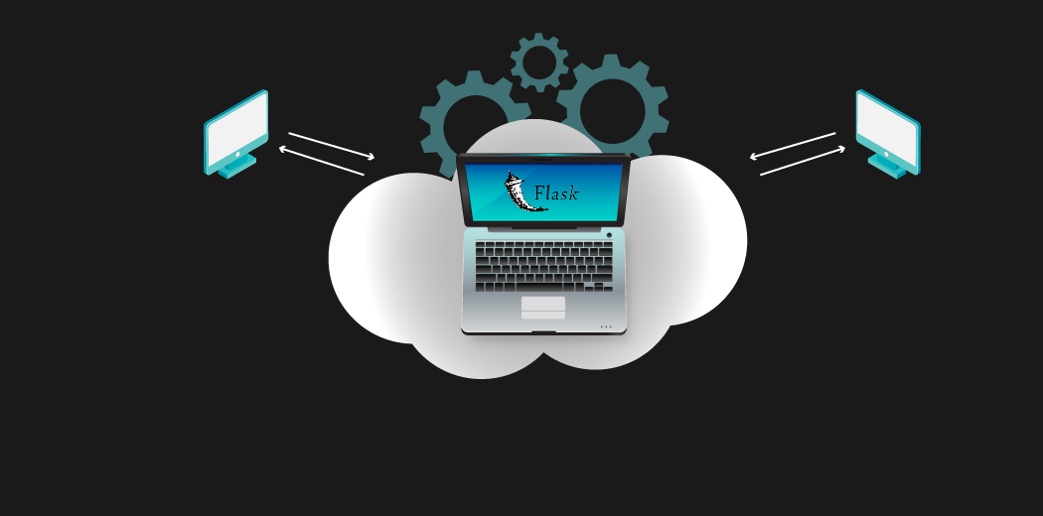
Flask Application
Flask can be utilized to create a web-based application that enables users to submit their data and receive an estimation of whether they are likely to make a service payment call within the next 5 days. To get started, we can install Flask through the command pip install Flask in the command window or terminal. Following that, we can import Flask and construct a new Flask object in a new Python file (Flask.py). This object will act as our web application.

Slide 12
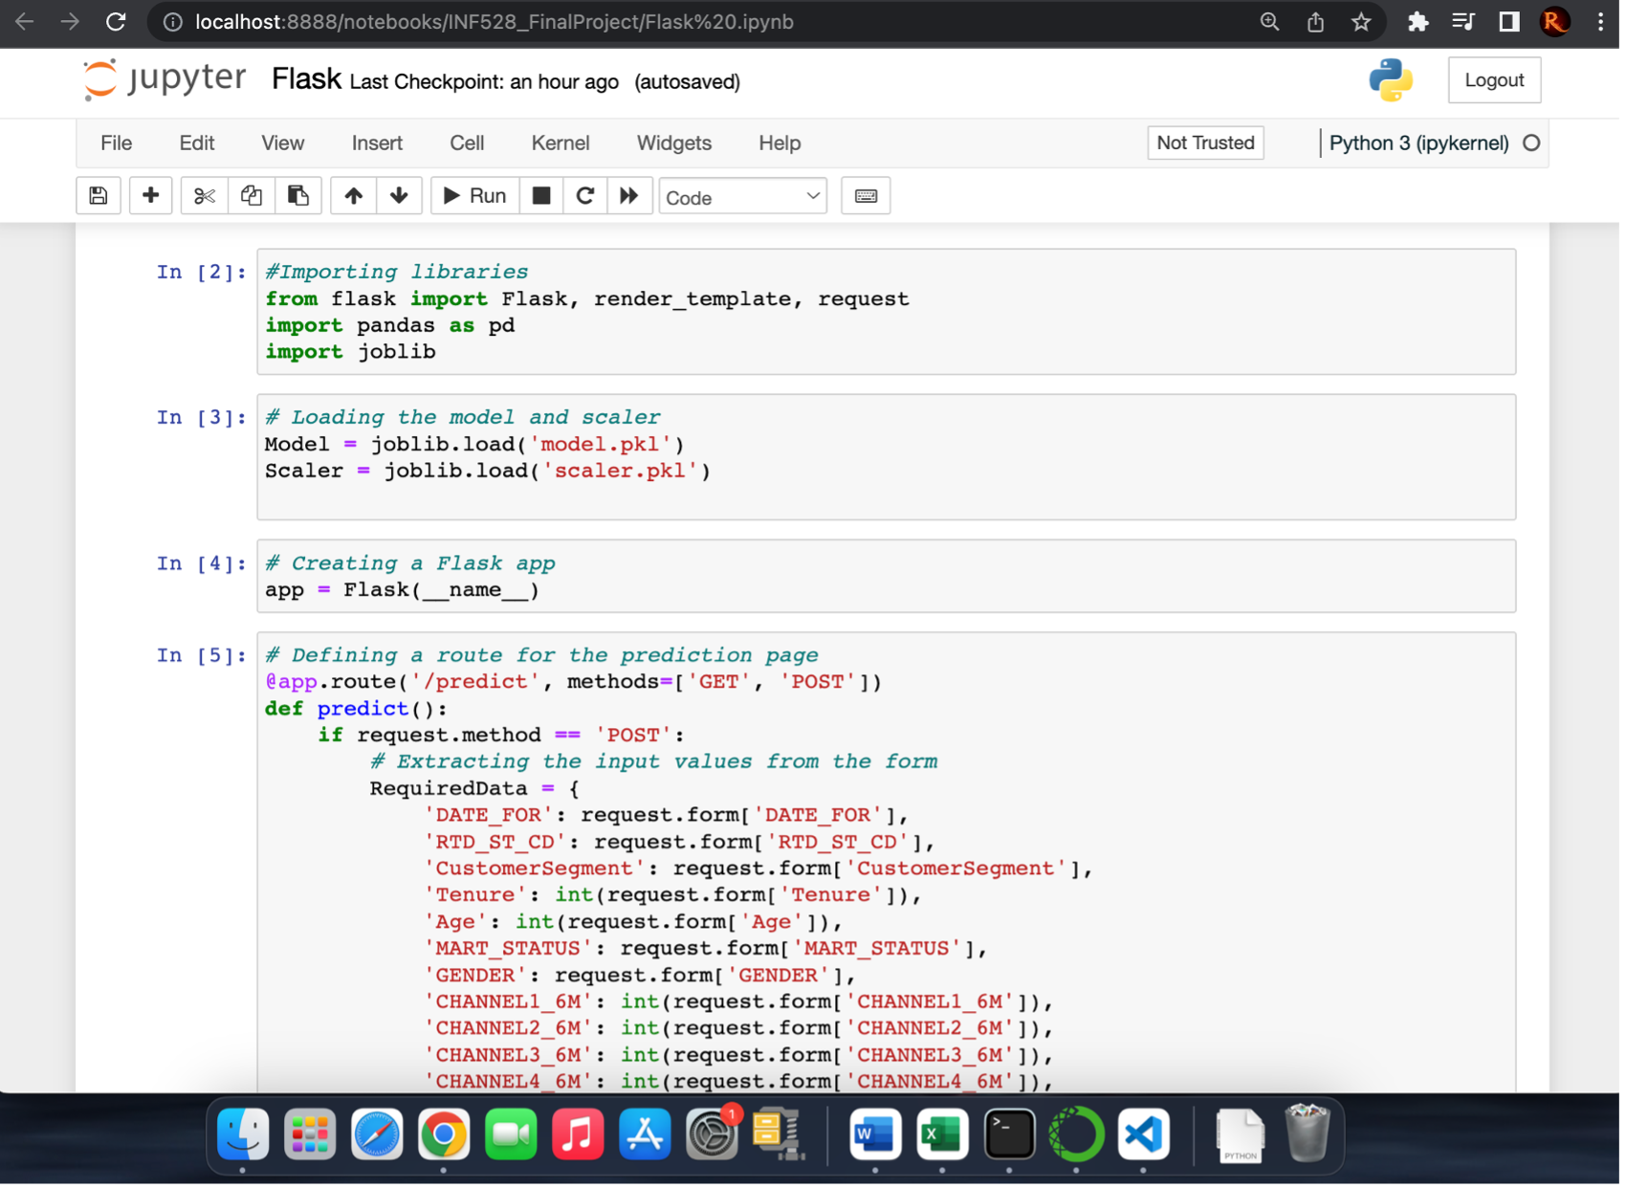
Workflow
We load the libraries Flask, Pandas and joblib for building a web app, processing data and building our machine learning model and scaler, respectively. For handling inbound requests through HTTP, we employ a decorator (@app.route) for constructing a route. This route forms the URL for accessing our app's content. To process form submissions, we define a function (RequiredData) that extracts form values and applies our model to make predictions.

Slide 13
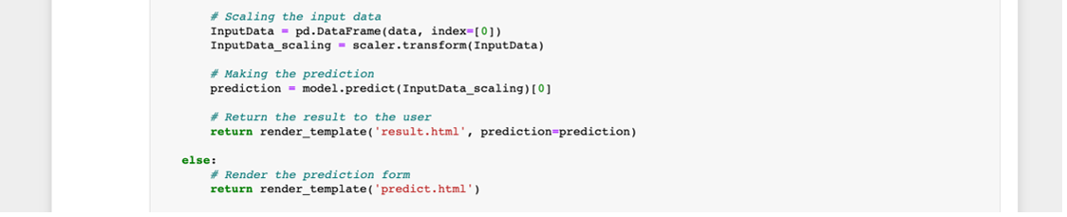
Templates
We provide users with the result of the prediction by creating two HTML files (predict.html and result.html) which enable the input of necessary data for the prediction (predict.html) and the display of the prediction score (result.html).

Slide 14
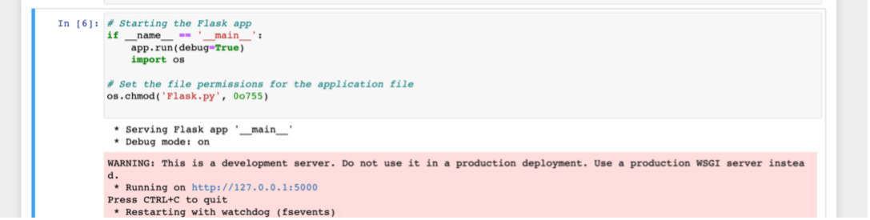
Starting the Application
Finally, we utilized the app.run() function to initiate the Flask application, launching the development server which enabled access to the application through a web browser. We were able to launch the application, however, there appears to be an issue with the sequence class from the collections library which is hindering the URL from loading.

Slide 15
Thank you!

